Slide 1
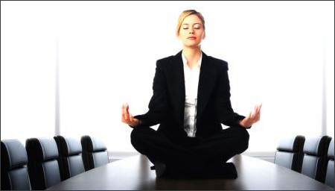
Stress management

Slide 2
Pressing issues
How to overcome stress?
How to protect yourself from stress?

Slide 3
Definition
“Stress management – it is different types of
interventions, which are carried out to fight
stress. These interventions involve preventive
measures. For example: training, courses,
working with specialists, etc”.
J. Bright and D. Fiona

Slide 4
Practical advice
Realize the situation – it is such as it is.
You do not change the situation if you panic. It
will be better if you do not give vent to your
emotions.
Schedule an exit plan out of the situation.
What to do in this situation? Write a list of
options.

Slide 5
People who can help you
Own talents and skills
Just ask yourself questions which connect with
your hobby and profession
What do I love?
What I like to do?
What profession is closest to me?
Do I like this?
3. Do not be afraid to say directly what you want in the future, how do you see your future life.
Realize your desires, turn it into goals and steps to
achieve the goals. Direct your thoughts in
this direction.

Slide 6
4. Do not let your self-esteem fall in difficult situations.
Think about your failures and successes. Read stories of
people who were at the "bottom" and "up". Stress cannot
be eternal. Depression will pass.
5. Pay no attention to the opinion of the other people.
It distract of the main tasks.
6. More activities and actions.
Be an active person, do not fail into despair. Try to
Develop more time to sport.
7. Rest.
Rest is a great way to bring your nervous system back to
normal. Take your favorite things, distract from all the
problems for 2-3 days.

Slide 7

Antistressful rules of behavior

Slide 8
Get up in the morning for 10 minutes
earlier than usual.
You can avoid the irritation of the morning. Calm
and orderly morning reduces trouble.
2. Do not rely on your memory.
Keep a diary.
3. Count your luck.
Memories of good reduce your irritation.

Slide 9
4. Get enough sleep.
Energetic condition improves efficiency and
Increases stress resistance.
5. Keep things in order.
The order on the desktop helps to be calm.
6. Make your holiday as diverse as possible.
Varied holding weekdays and weekends helps
boost your performance.

Slide 10
Remind
How to overcome stress?
How to protect yourself from stress?

Slide 11
Stress management - this is what you need for a
fulfilling life. Trying to suppress stress - means to
fight with yourself. But learn how to manage
them - it means creating a resource which
allows you move through life.

Slide 12
Thank you for attention!

